Slide 1
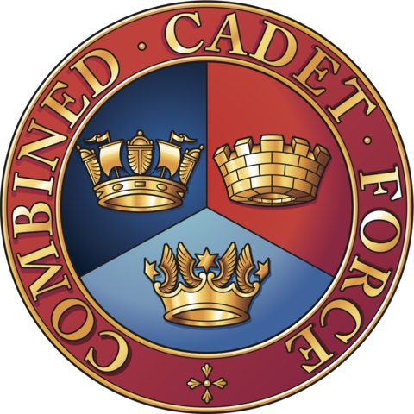
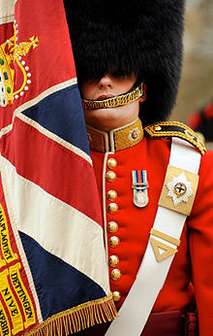
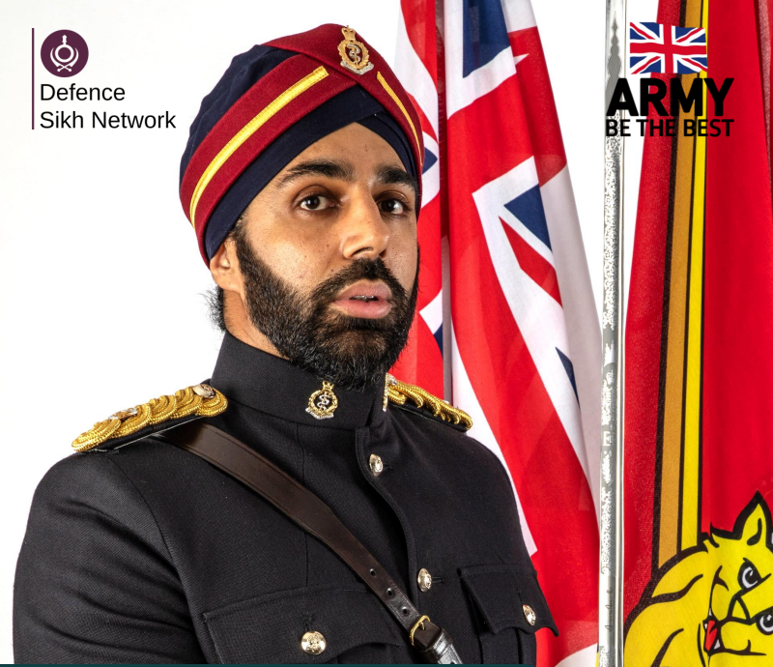
Pioneer Secondary Academy
Y9-13
Combined Cadet Force (CCF) Company
Coldstream Guards

Slide 3
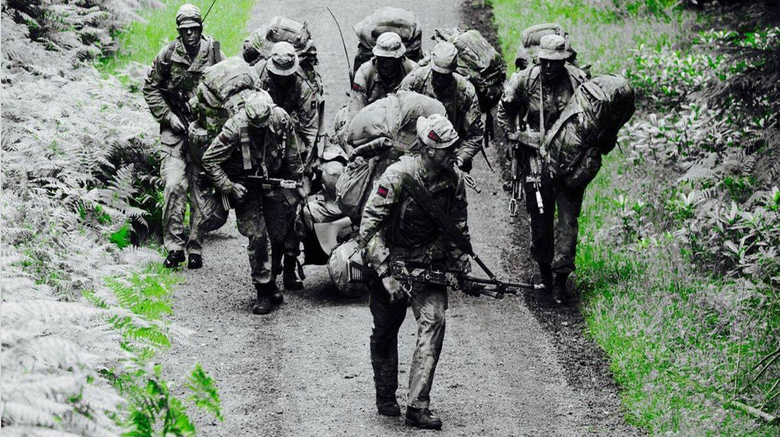

Slide 5
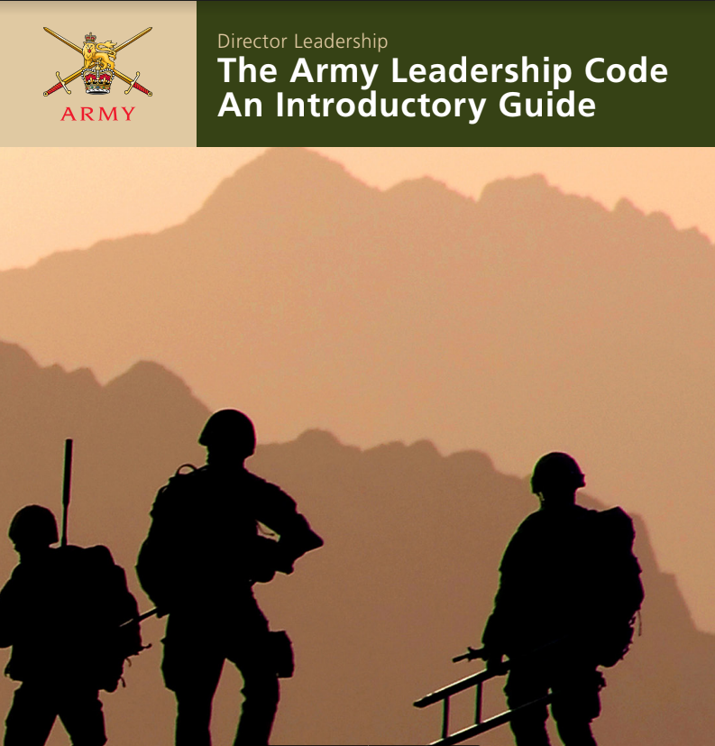
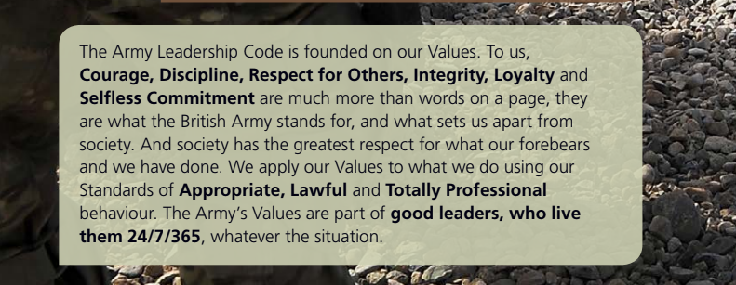

Slide 6
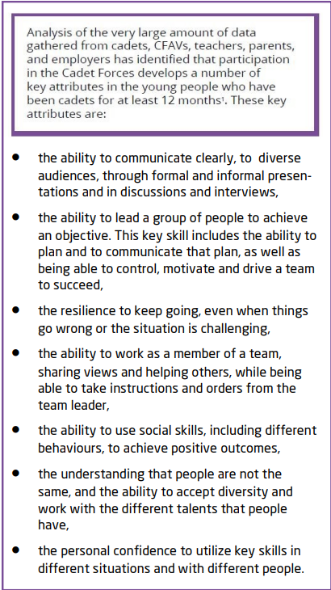

Slide 7
CCF History
CCF History
The tradition of cadet units in schools goes back over 150 years to the 1850s. In 1948, the Combined Cadet Force was formed, covering cadets from all three Services. In 1859, the idea of cadet units in schools was developed by the Secretary of State for War, Jonathan Peel - who wrote to public schools and universities, inviting them to form units of the Volunteer Corps. Several schools took up the idea, and the first Cadet Corps in a school was formed in 1860 at Rossall School. Other units formed soon after at Eton, Harrow, Merchant Taylors’, Rugby, Hurstpierpoint and Felsted School - although Felsted School's armed drill contingent pre-dated the 1859 letter from the War Office.
These early units were focused on Army activities, and were usually associated with Rifle Volunteer Battalions for Home Defence, with cadets wearing the uniforms of their parent volunteer battalions. The Corps evolved over time, focusing on Officer Training - and during the World War I and II, many of the young men who served in the units went on to serve their country in the Armed Forces.
​
After World War II, the structure of the Armed Forces changed, including the cadet units in school, which became the Combined Cadet Force in 1948 - incorporating sections from all of the Armed Forces, the Royal Navy, Royal Marines, Army and Royal Air Force. Over the following decades, the focus of the group moved away from being a recruitment pathway in to the Armed Forces, the number of CCFs in state schools slowly grew - and for the first time girls were allowed to join.
​

Slide 8
CCF Today
How many schools have a CCF?
Prior to the current Cadet Expansion Programme there were 237 CCF contingents based in both state and independent schools and colleges throughout England (61 in state funded schools and 176 in independent schools).
Today the Combined Cadet Force contingents are very different to those early groups of young people. Although they are still based on the ethos of the Armed Forces - their focus is on helping young people to develop and reach their full potential by providing challenging, active, adventurous and fun activities.
​
There are CCF contingents in almost 500 secondary schools all over the UK, ⅔ in State Schools and ⅓ in Independent Schools. offering young people a broad range of challenging, exciting, adventurous and educational activities. Our aim is to enable the development of New skills, Friendship, personal responsibility, leadership and self-discipline. Each CCF is an educational partnership between the school and the Ministry of Defence, and a CCF may include Royal Navy, Royal Marines, Army or Royal Air Force sections.
There are 4190 secondary schools in the UK and 2461 independent schools. Of all schools in the UK only 7.5% have a CCF Contingent.

Slide 9
CCF Rationale
“The broad function of the Combined Cadet Force is to provide a disciplined organisation within a school so that young people may develop powers of leadership by means of training to promote the qualities of responsibility, self-reliance, resourcefulness, endurance and perseverance, and a sense of service to the community. It is firmly believed that the self-discipline required in Service life are equally important in the civil life of the nation today. The specific functions of the service training in the CCF are to provide the opportunity for young people to exercise responsibility and leadership, and to learn from the services how they can best be developed.”

Slide 11
Pioneer CCF Company
Introduction
The Pioneer CCF is a voluntary youth organisation under the banner of the MOD cadet forces whose mission is to make the children of today better citizens for tomorrow by instilling in them the values of the British army: Courage, Discipline, Respect for others, Integrity, Loyalty & Selfless Commitment. The motto is to aspire to achieve. This is done via a structured syllabus that includes the following subjects
Drill, Navigation (Map & compass), Field craft, Skill @ Arms, Shooting, 1st Aid and methods of instruction. The primary difference in approach between the (school based) CCF and the Community Cadet Forces (ACF) is a clear focus on Leadership development. This syllabus leads to cadets obtaining:
Army Proficiency Certificate – Basic
Army Proficiency certificate – Advanced (Infantry) – possible promotion to Lance Corporal
Junior Cadet Instructors Certificate (Corporal) - CCF
Senior Cadet Instructors Certificate (Sergeant) - CTT
Master Cadet Certificate (Colour Sergeant) - CTC
Bronze/Silver/Gold Duke of Edinburgh Awards

Slide 12
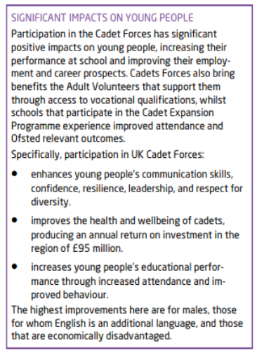
Forecast of Events (FOE)
DoE Bronze Expedition – Chiltern Hills 2 days – 1 night, 2 days
DoE Silver Expedition – Peak District 3 days – 2 nights, 3 days
DoE Gold Expedition – Brecon Beacons 4 days – 3 nights, 4 days
DoE Gold 5-day residential challenge
Mountain Adventure Training Camp – Peak District – 2 nights, 3 days
Lost Earth Adventure Training Camp – Yorkshire Dales – 4 nights, 5 days
Snowdonia Outward-Bound 4 nights, 5-days adventure challenge
Skill at Arms Training weekends
Navigation exercises – Stoke Common
Longridge – Water Based Adventure Training days
3 x Woodland Paintball Battle Drills afternoons
1 x Paintball Battle Exercises - afternoon
2 x ACF/CCF Weekend Camps – 1 night, 2 days
CCF Army Summer Camp – 4 nights, 5 days

Slide 13
Parent: Describe in your own words what you think your child has enjoyed this year in the CCF and what it has done for in terms of his/her personal development?
My child has benefited enormously as a result of being a part of CCF. I've seen her grow and develop in a number of areas, including discipline, education, confidence, leadership and resilience - while also enjoying the sessions and having fun! Neither my daughter or I could have imagined her doing the sorts of activities that she has found herself involved with. Leadership is a key value-add for my daughter, and I see her skills and abilities in this area going from strength to strength. Life is never easy - but if our children can be taught to be more prepared and ready for the 'big wide world', that's got to be something quite special - and I can confidently say that CCF has given this to my daughter. Her outlook on life is now a very different one to how she saw the world prior to joining CCF - and I can only say a huge 'thank you' to the great Leadership team at Pioneer CCF for everything they do for our children.

Slide 14
Cadet: Describe in your own words what you have enjoyed this year in the CCF and what it has done for you in terms of your personal development?
Over the years, I have spoken to many visitors and OFSTED members about CCF, and have had no doubt in my mind when telling them that CCF is the best part of PSA. It is something that not many schools have the opportunity of - and we are so lucky to be able to join such an amazing unit. Before joining CCF, the residential trips like DofE and Lost Earth, are things I never thought I would be able to do, and things I never would have even thought about doing for a second, but after joining, I can proudly say 'I've accomplished that' to almost everything I thought I would never be able to do. CCF has hugely improved my confidence, leadership, and self belief, making me both mentally and physically stronger, more resilient and always looking forward to every CCF session. I have also learnt how to deal with difficult situations, and to have greater confidence in my abilities. I can honestly say that CCF has made me the person I am today, and I really don't know what I would have done without joining. It is truly the best decision I have ever made!

Slide 15
Parents: Describe in your own words what you think your child has enjoyed this year in the CCF and what it has done for in terms of his/her personal development?
Pushed her to try new things she wouldn’t agree to otherwise and allowed her to interact with pupils outside her daily friends.Learned many new skills she’s proud to know about!
I had good experience with my son.We went together in Black Park, it was quite dark. I didn’t know how to come out and I was really panicked because we were lost. Because of my son joining the CCF he was really confident and learn from CCF how to find the right way. He was leading me and showing me the right path. At that time I realised joining the CCF was my right decision. I want to say thanks to all his CCF teachers who teach them about confidence,hard work, and the right path of the life. Strongly recommend to other parents, don’t leave this opportunity join CCF. Thanks everyone.
CCF has been the one constant during the last year for my daughter. There have been a lot of changes at the school (school change, teachers leaving, cover teachers, lack of structured lessons in many subjects etc). There have been no other extra-curricular activities offered by the school so CCF has been excellent to help her develop new skills (navigation, first aid etc). Moving forward may I suggest keeping parents updated on progress our children are making with CCF? (changes to ranks, skills passed etc).
My daughter has enjoyed learning how to manage her own needs, shop and find good quality items needed for each trip and pack sensibly. She has found which shops she needed to go to in good time to purchase the required items. She has enjoyed every trip, working as a team, having healthy friendships with her peers and cooking her own food. All very important life skills.
CCF has pushed my daughter out of her comfort zone to try new and different things that she has never done before, including the trips she has attended. She has had lots of new experiences and has overcome challenges. She has also gained lots of confidence and pride to be given this opportunity. It has really helped her personal development. Lastly, my daughter is very grateful for this opportunity as she has gained lots of knowledge which makes her excel in other things.

Slide 16
Cadets: Describe in your own words what you have enjoyed this year in the CCF and what it has done for you in terms of your personal development?
The CCF has improved my self-confidence and my ability to face my fears. I would highly recommend new students to join the PSA CCF and be a part of a great and a wonderful team/unit.
Joining CCF was one of the best decisions I have made in this school as I have learned a lot of new skills that will be very useful in life which may be survival skills or just simple general skills .I have also become more confident with talking to people as I have had to work with teams I did not know but now I am great friends with them and my confidence has grown a lot .Being in CCF has also helped me speak up for myself and share my own ideas when working with others. I have enjoyed going on all of the trips and making lots of memories.
I have done things I never would have done otherwise and it’s really helped me learn more about myself as a person and what my capabilities are and can be.I’m more confident doing things I’d probably deem as “scary”-hugely improved my self esteem
In general, CCF has pushed me past all of my comfort zones. Since joining in the start of year 9 I fell that my confidence and leadership skills have grown. Longridge, Delta Force and DofE have played a massive part in my development. Last but not least Wednesday parade has broadened my military based knowledge. Over all, CCF has been amazing and I can't wait for next year!
I have enjoyed all the experiences I have gained by joining CCF. I have taken part in dofe and have come out of it with lots of skills that will help me in my life. I will also be going to Wales in 3 weeks time. The CCF has been a great way to get out and do things I wouldn't usually. It has helped build on my team working and leadership skills, it has also improved my confidence in other things.

Slide 17
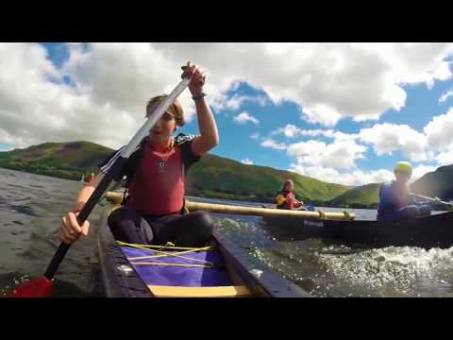
Outward Bound & Adventure Training

Slide 18
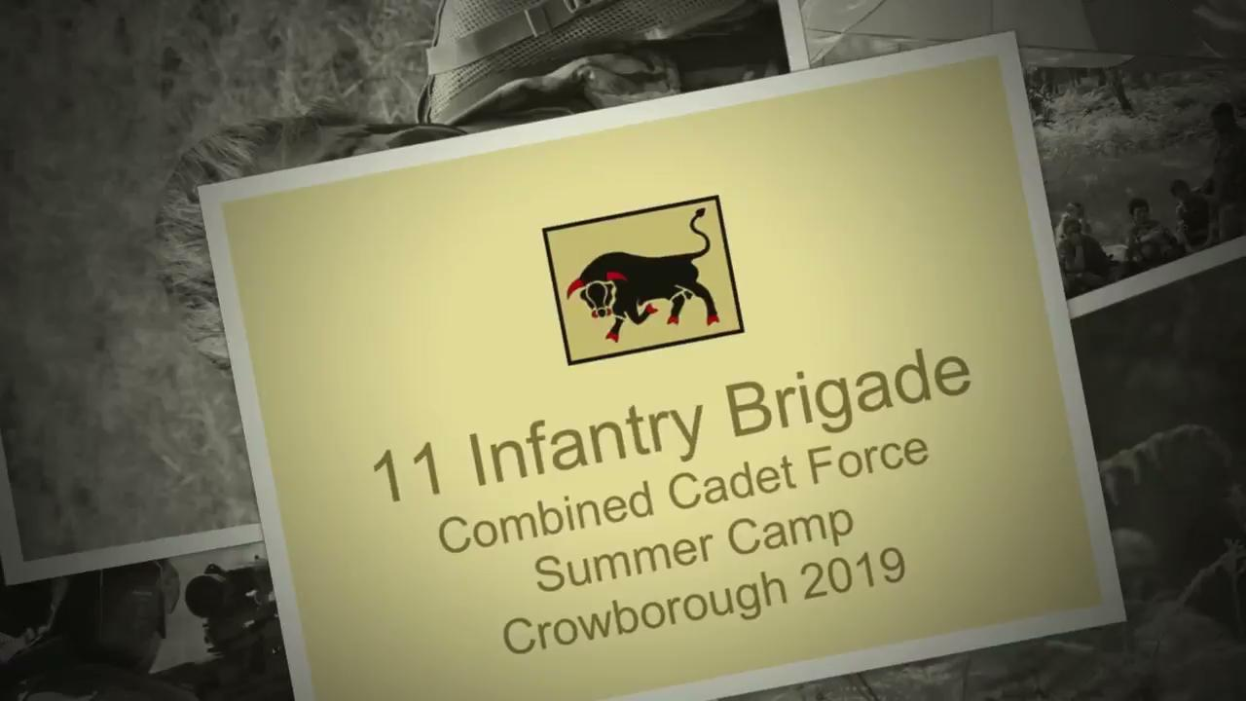

Slide 20
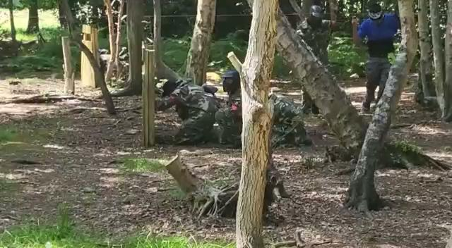

Slide 21
